Slide 1
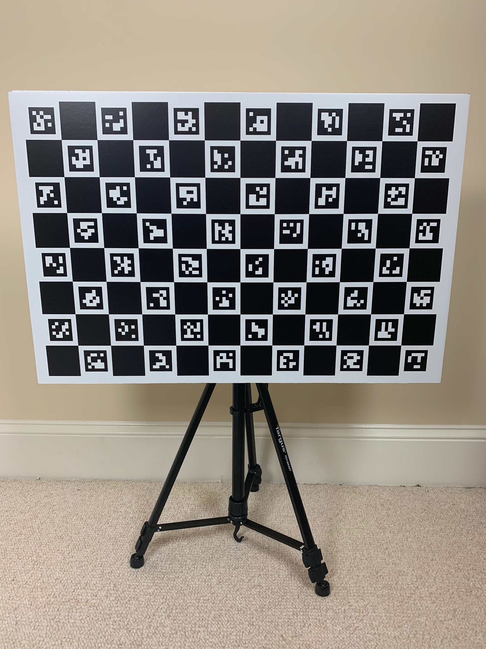
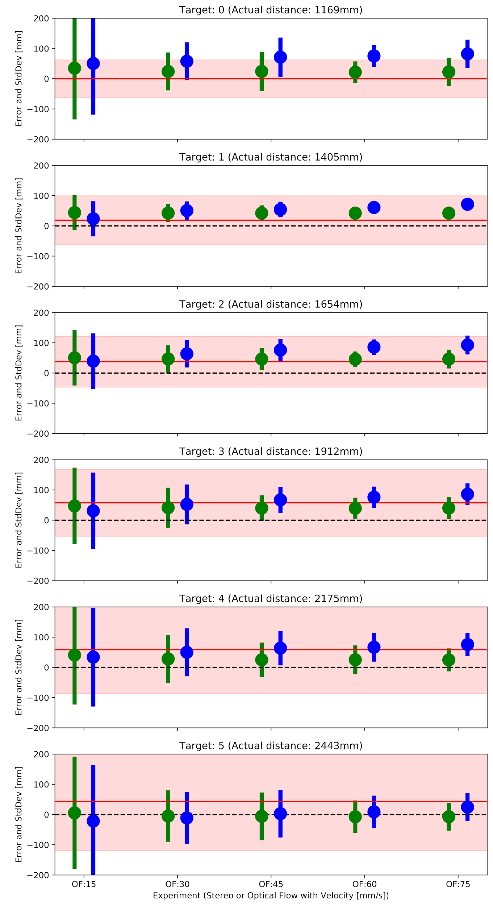
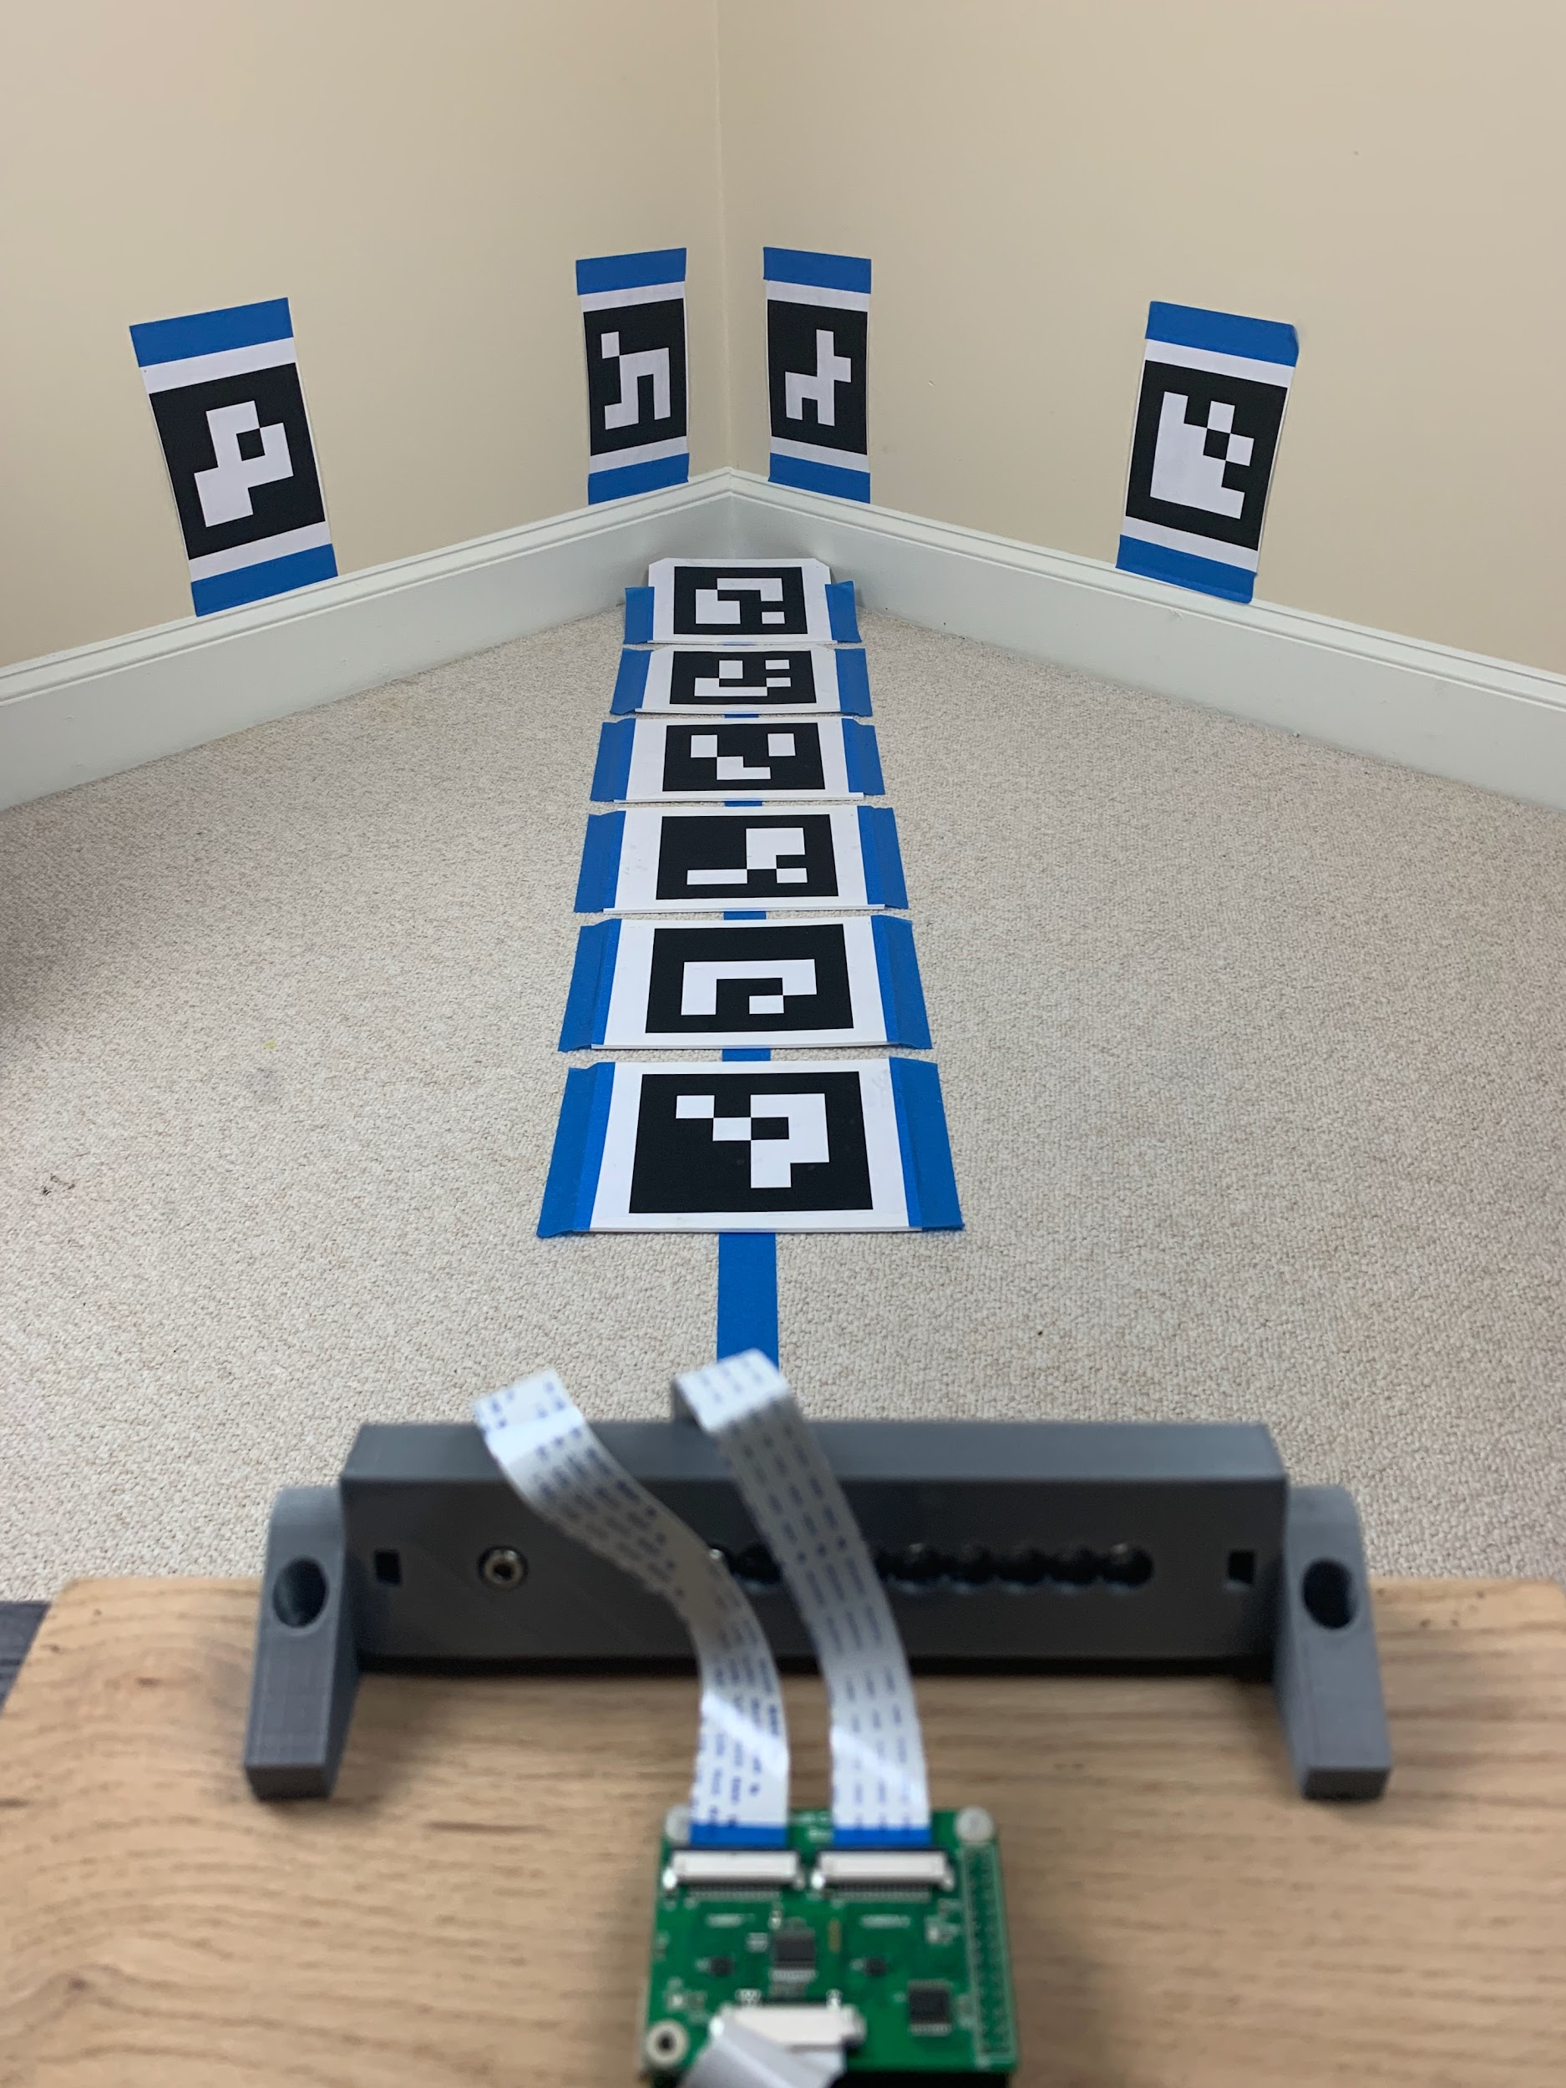
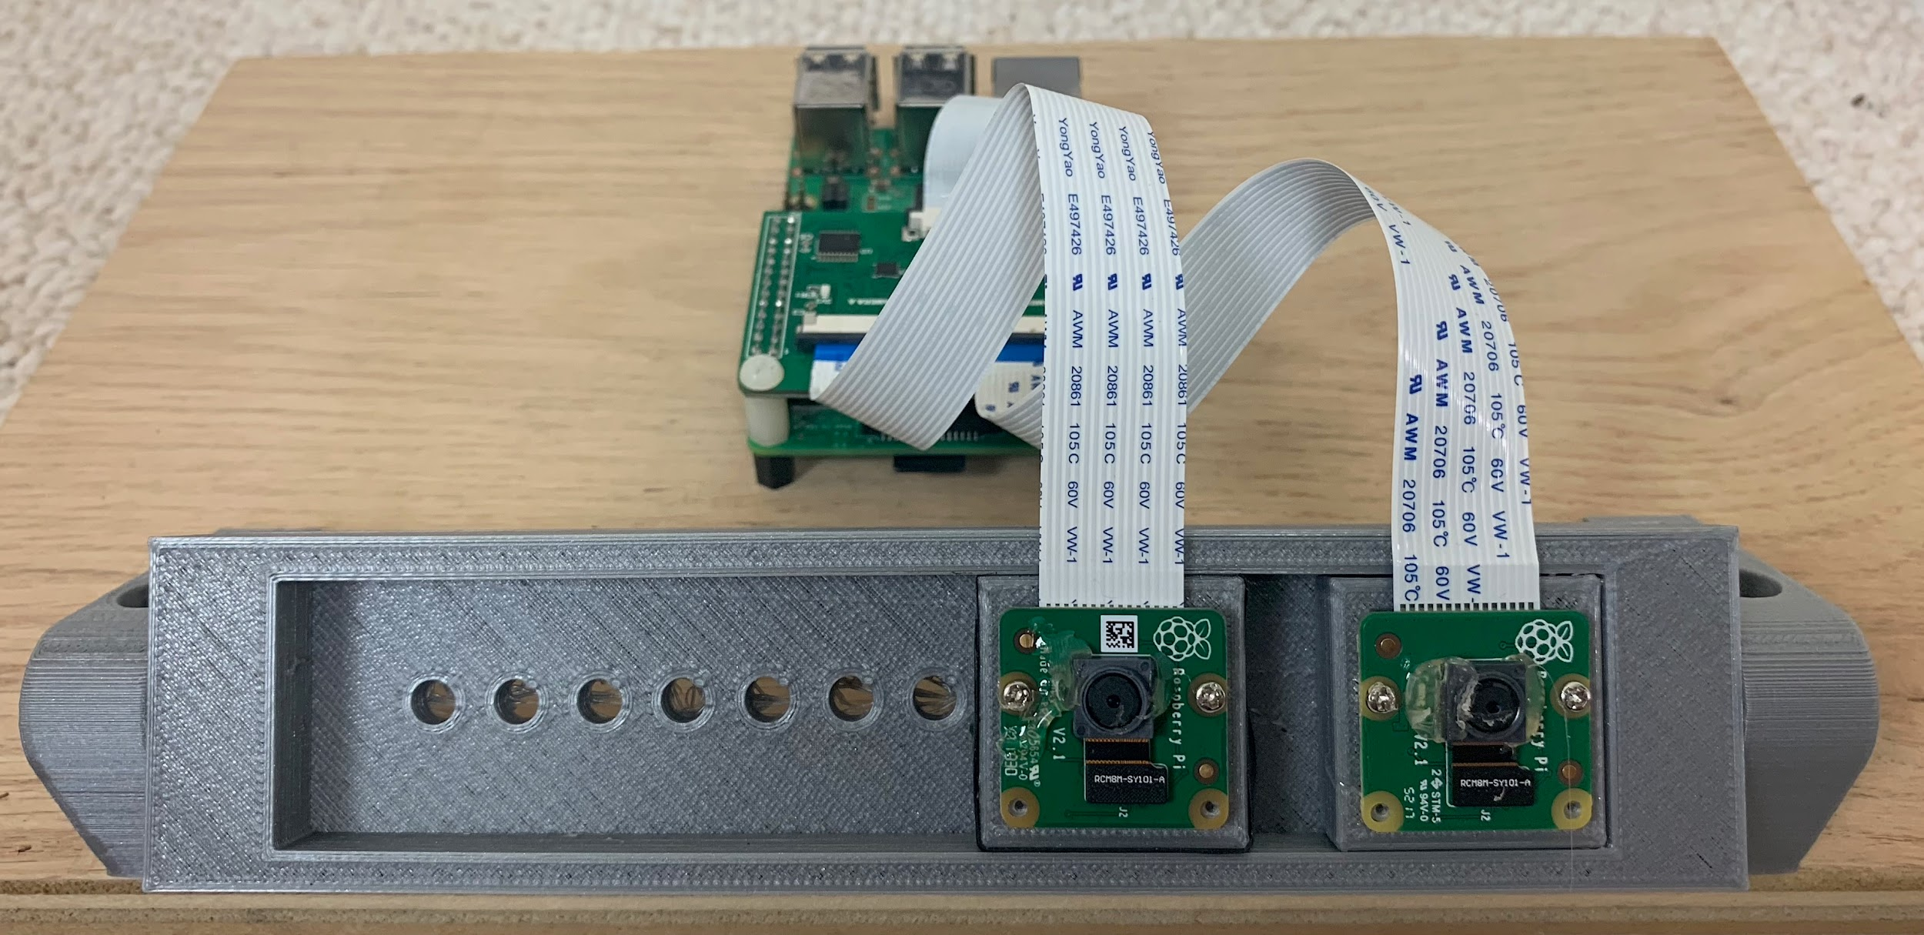
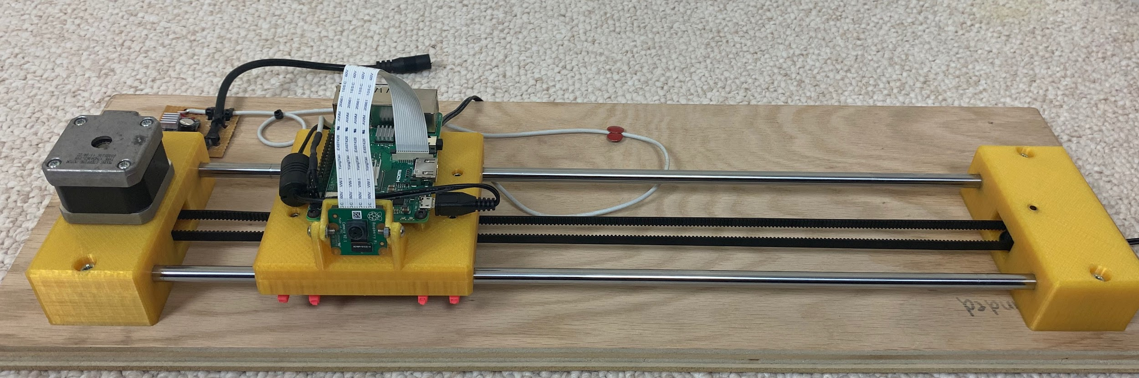
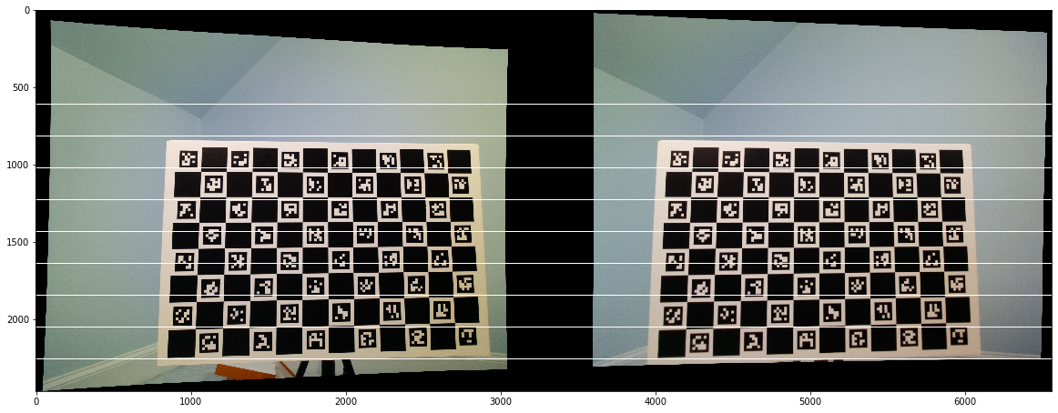
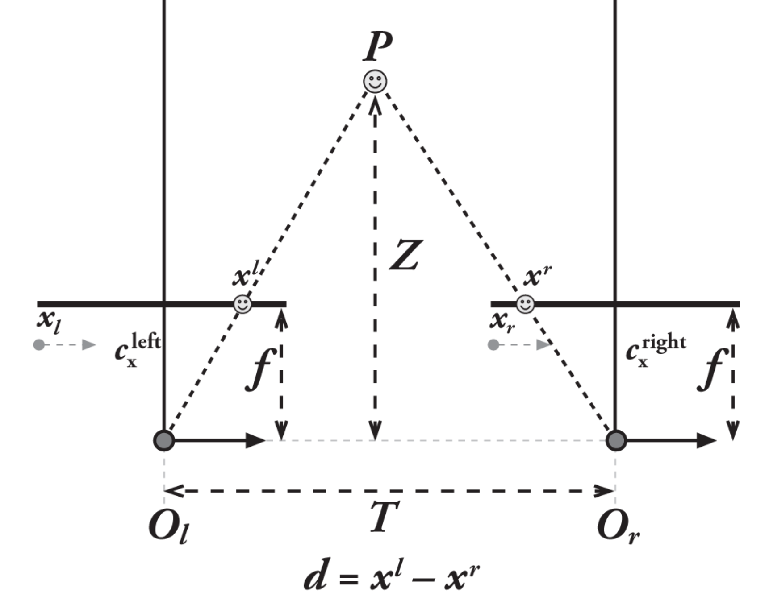
3D Robotic Vision Using Movement
by Marc van Zyl
Problem
Experimental Process
Final Results
Despite rapid advances in robotics, robots are being held back by an inability to accurately move around in structured and unstructured spaces. The core problem is that robots cannot “visualize” 3D space the way that humans can. I believe that Optical Flow (OF) algorithms may be more effective to develop 3D visualization than stereo vision for many applications.
To ensure consistency across the cameras, they were calibrated against a flat board with Aruco markers. The calibration process uses many photos of the board in different orientations to develop a camera model to remove the warping and distortion that all cameras have. This is an important step for accurate results because it controls for camera differences.
The experimental scene (shown below) was designed to ensure controlled distances to the Aruco target objects and controlled lighting.
Error and Standard Deviation of Error Between Experimental Results and Actual Target Distances
Camera Calibration
Stereo Camera
Error
Stereo Camera
StdDev
Sparse Optical Flow
Error and StdDev
Dense Optical Flow
Error and StdDev
Camera Calibration Board with Aruco Markers
Hypothesis
Stereo Camera
Error
Stereo Camera
StdDev
Sparse Optical Flow
Error and StdDev
Dense Optical Flow
Error and StdDev
If the OF algorithms on a moving camera are able to measure distances to objects in a controlled environment more accurately than a stationary stereo vision camera, then they will be a useful alternative for machine vision.
Optical Flow Camera Setup
1 Arducam 8MP IMX219 camera mounted on custom designed 3D-printed linear slide assembly
Raspberry Pi 3B+ for video capture and to control slide motion
Arduino Nano with GBRL and stepper driver
Stepper motor connected to toothed belt to drive slide
Stereo Camera Setup
2 Arducam 8MP IMX219
cameras mounted on a custom 3D-printed camera mount
Raspberry Pi 3B+ with Aruducam MultiCamera board for stereo image capturing
Stereo Camera
Error
Stereo Camera
StdDev
Sparse Optical Flow
Error and StdDev
Dense Optical Flow
Error and StdDev
Control Group - Stereo Vision
A self-built stereo vision setup using two digital cameras mounted on a stable base. Distances to known target objects will be determined using pixel disparity algorithms.
Stereo Camera
Error
Stereo Camera
StdDev
Sparse Optical Flow
Error and StdDev
Dense Optical Flow
Error and StdDev
Experimental Setup
Controlled Experimental Setup with Aruco Targets
Experimental Group - Optical Flow
Stereo camera setup with two cameras connected to
Raspberry Pi using multi-camera module
Optical Flow camera and Raspberry Pi on a precision linear slide controlled by a stepper motor
Stereo Camera
Error
Stereo Camera
StdDev
Sparse Optical Flow
Error and StdDev
Dense Optical Flow
Error and StdDev
A single digital camera on linear slide driven by an accurate stepper motor. The distances to the target objects will be measured by using spare and dense optical flow algorithms.
Independent Variables
Stereo Camera
Error
Stereo Camera
StdDev
Sparse Optical Flow
Error and StdDev
Dense Optical Flow
Error and StdDev
Camera setup and algorithms (Stereo, Sparse OF and Dense OF)
For the optical flow setups, the linear velocity of the camera during recording
Conclusion
Rectification to compensate for rotation and translation of camera
For the special case of linear camera motion, the experiment confirms that Optical Flow algorithms can achieve comparable accuracies to traditional Stereo vision systems with much lower variance in measurements. While the overall accuracy of Stereo vision was greater at the very close distances, Optical Flow was more accurate at the longer distances. This is probably due to the Optical Flow algorithm using multiple images from the video stream to update measurements over time. This points to some interesting possibilities for robotic vision in the future. Dense optical flow is particularly interesting due to its ability to map a full scene and refine its accuracy over time.
The linear motion slide was calibrated to ensure that the velocity of the camera motion was constant and accurate. The kinematic features of the setup (motor steps per rotation, microstepping settings and the pulley diameters) were carefully calibrated.
Dependent Variable
Setup Calibration
Distance measured to the center of each known Aruco target in the experimental scene
Controlled variables
Experimental setup (lighting, target location, camera position)
Identical cameras and controlled exposure
Identical calibration and rectification process
Image preprocessing for contrast enhancement
The distance (Z) to a point (P) is determined by finding the disparity (d) between the point in the left and right cameras.
Linear movement of the camera causes images of objects to “flow” differently based on their distance from the camera. These differences can be used to calculate the distances.
Experimental Resources
Core Theory
Future Research
Raspberry Pi 3 B+
Pi Cameras V2.1
Jupyter Notebook (Python 3.7)
Thonny Python IDE
OpenCV 3 vision library
Left Camera
Right Camera
Pixel 1
OF₁ = (v_{x} , v_{y} )
Future research will be to enhance the algorithm to account for linear and rotational motion of the camera and to enhance the dense optical flow algorithm to identify separate objects and convert the scene into a 3D map.
Pixel 2
OF₂ = (v_{x} , v_{y} )
Frame at t=1
Source: OpenCV documentation
Frame at t=0

Slide 2
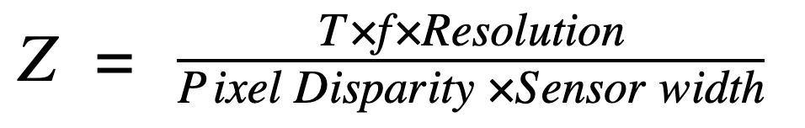
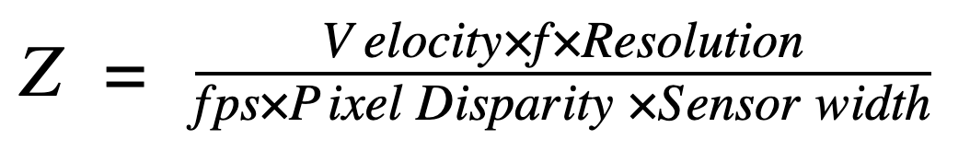
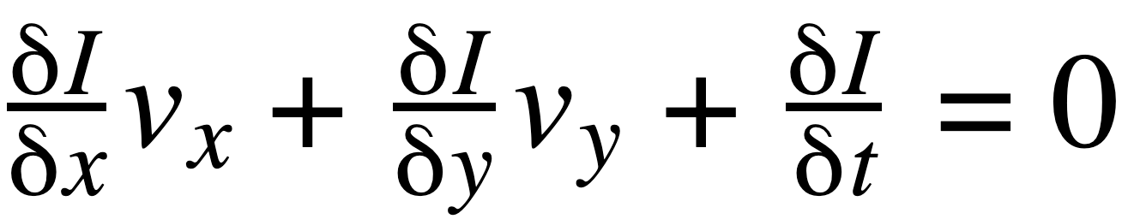
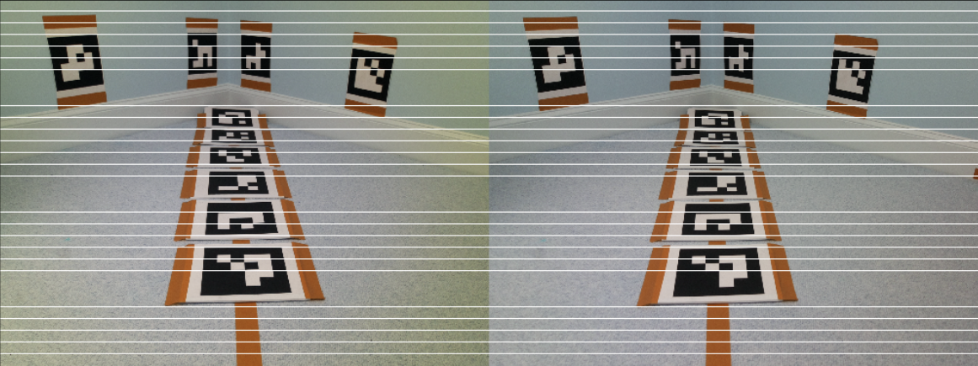
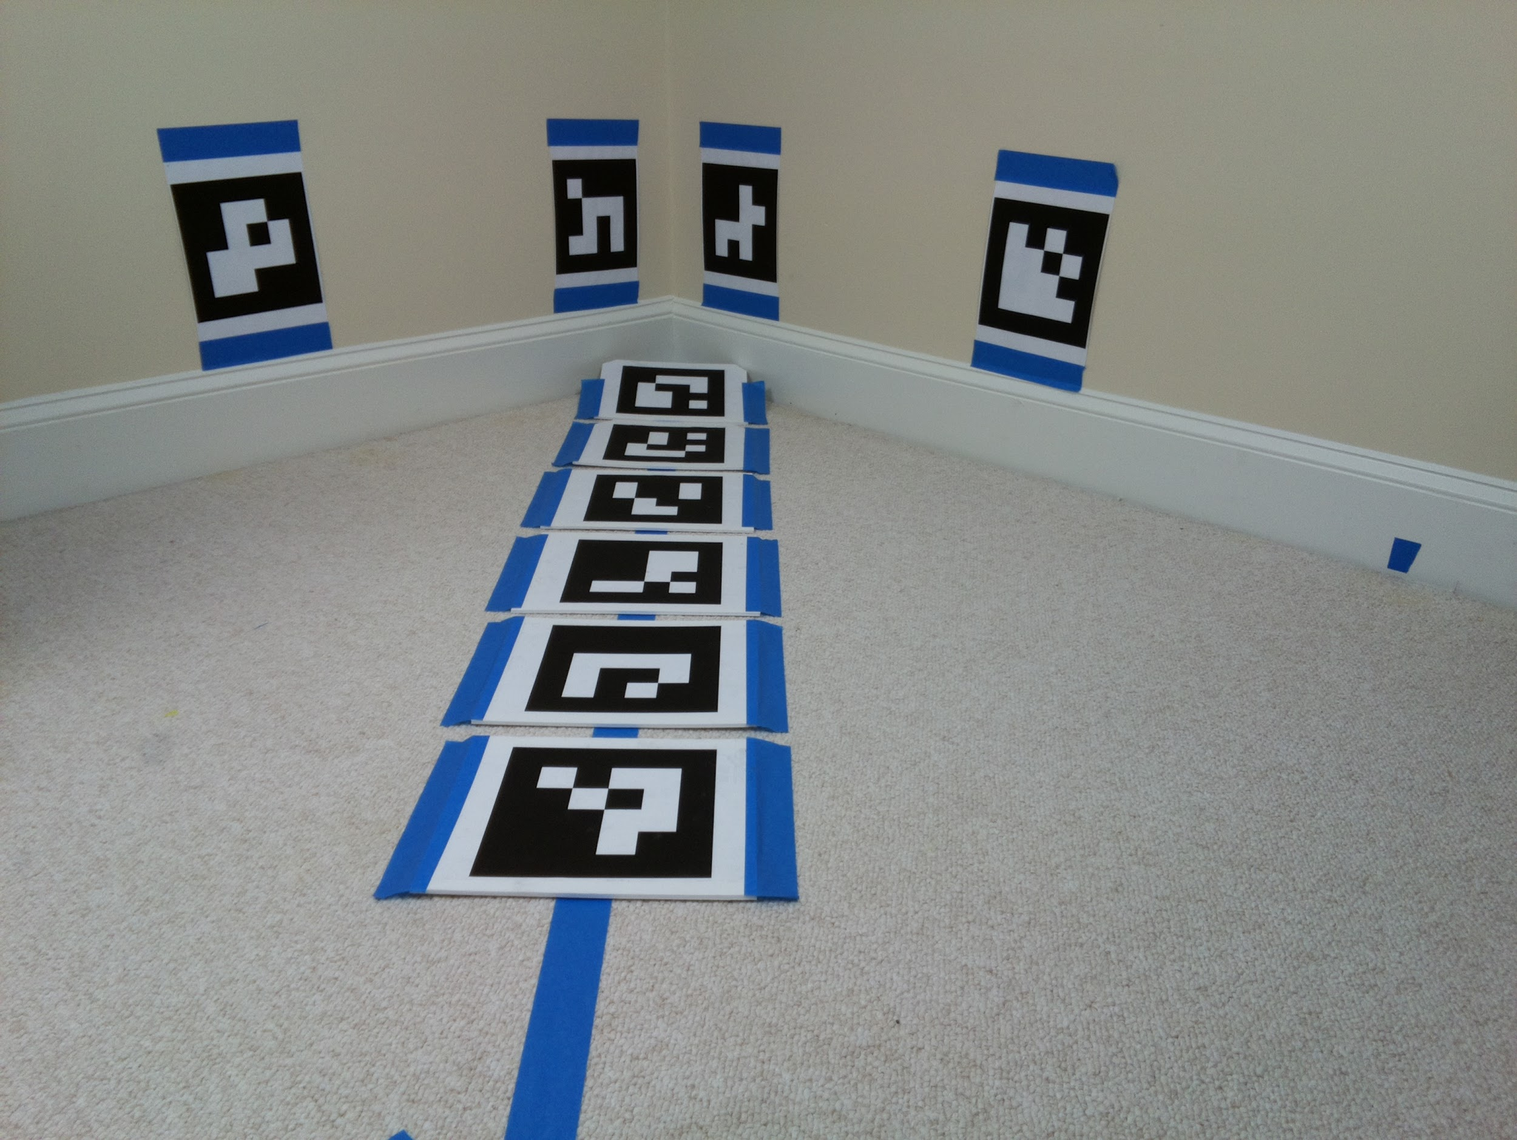
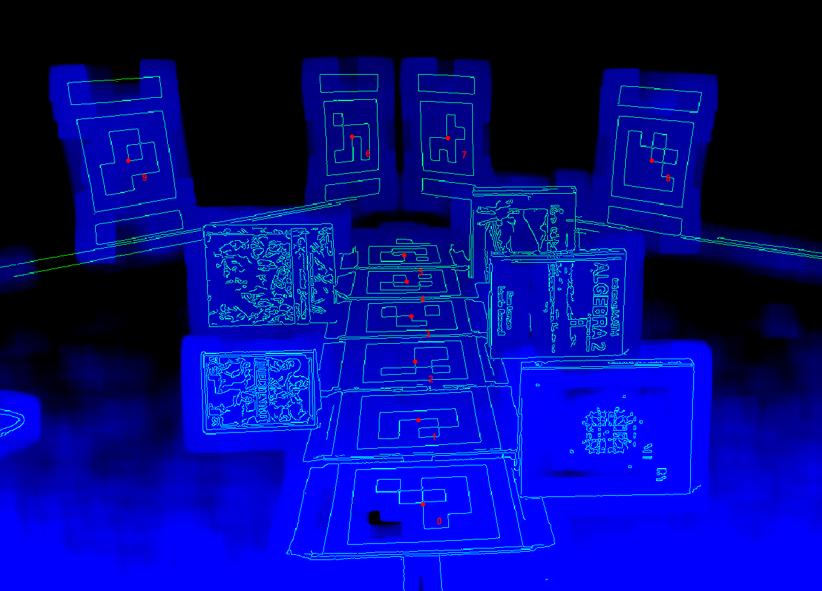
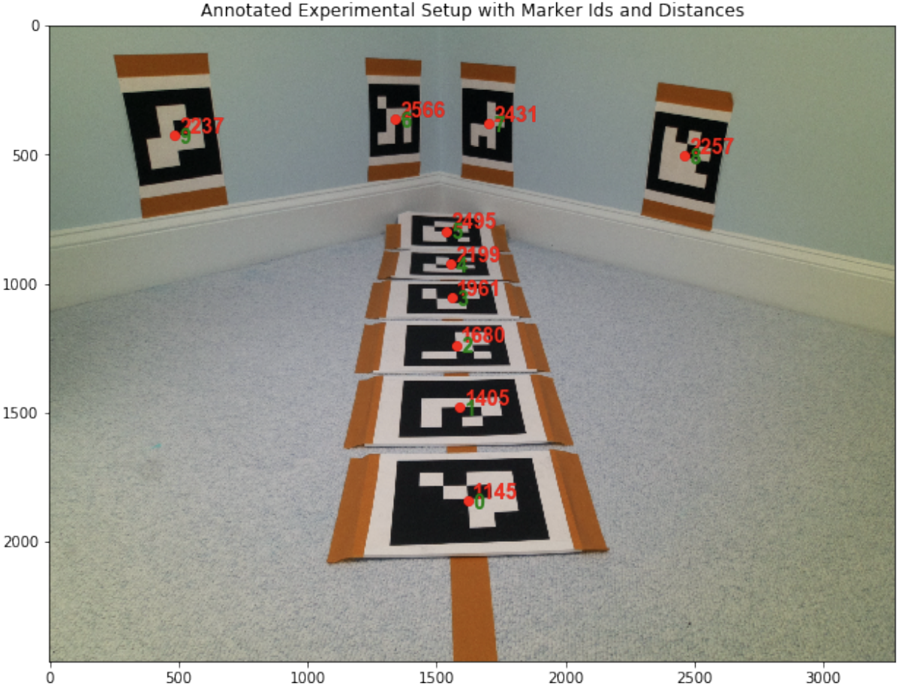
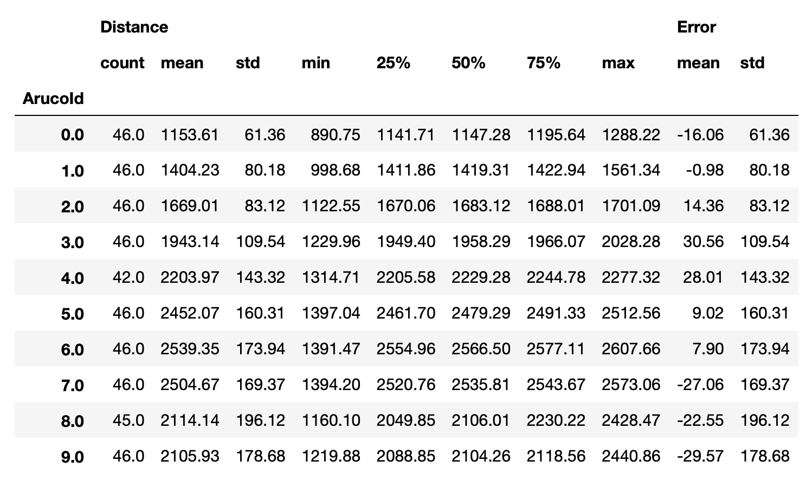
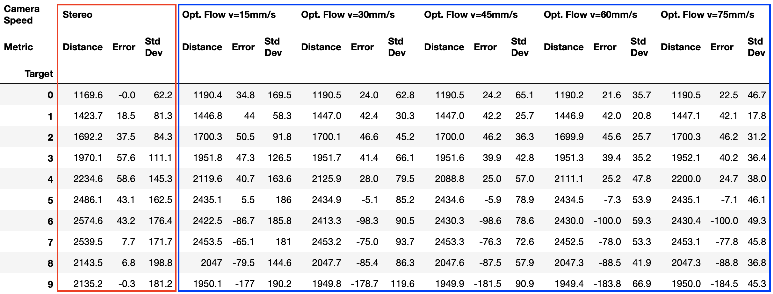
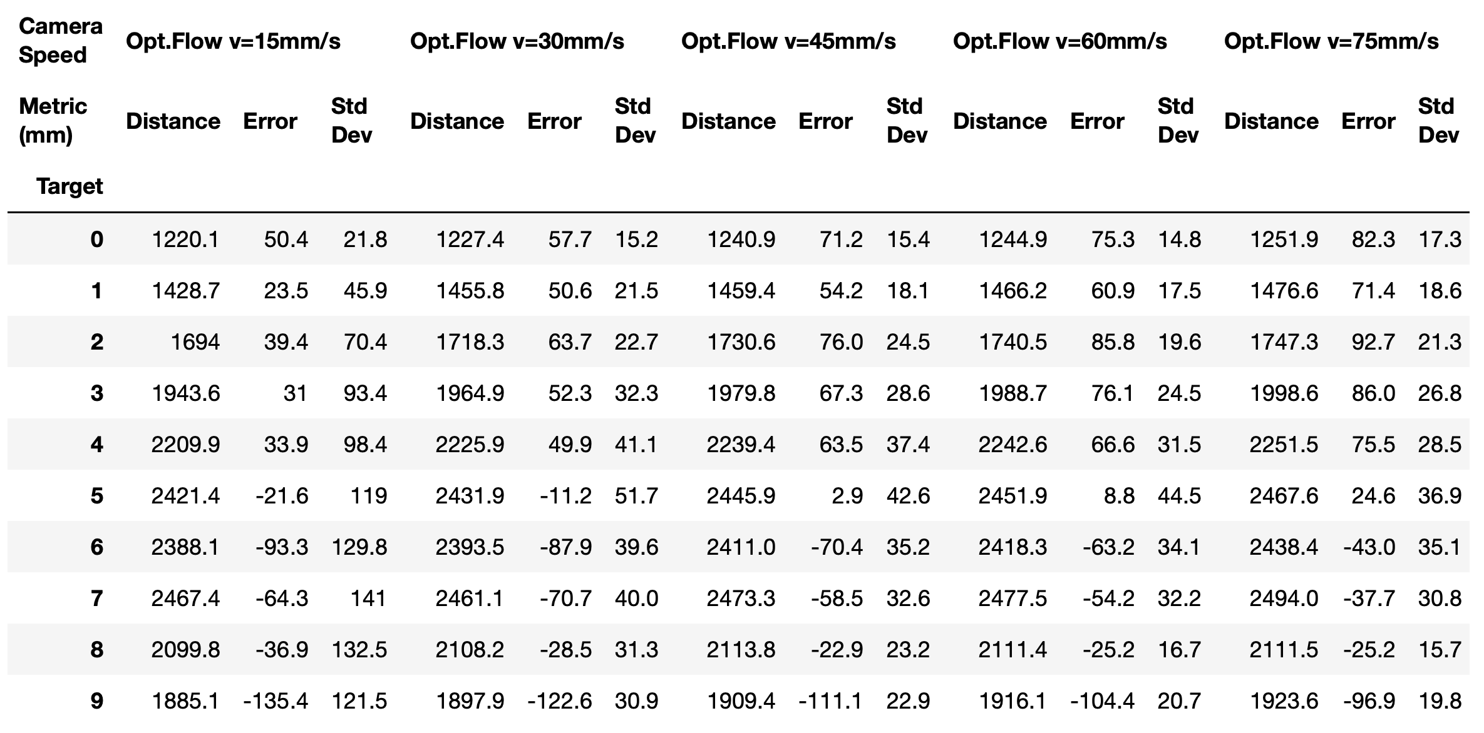
Experimental Procedure
Stereo
Sparse Optical Flow
Dense Optical Flow
Identify key corners on Aruco markers using the Shi Tomasi corner detector and find the position and Id of the center of each target marker in the left and right cameras.
Find left-right pixel disparity between the two images.
Calculate distance to each Aruco marker using the disparity formula above.
Identify key corners on Aruco markers using the Shi Tomasi corner detector and find the position of the center of each target marker.
Track and align the key points between video frames.
Calculate pixel disparity of the points between each video frame.
Use the disparity formula above to calculate the distance to each target.
Use two consecutive frames to calculate the optical flow for all points in the image using the Gunnar Farneback algorithm with a window size of 15 pixels.
Find the centers of the Aruco corners as before.
Extract the flow information for 20 x 20 square of pixels around the center of each marker and find the average flow.
Calculate the distance using the disparity equation from the sparse optical flow.
Stereo Analysis
Sparse Optical Flow Analysis
Dense Optical Flow Analysis
Rectified stereo images compared to find disparity
Example results for distance calculation to the centers of Aruco targets showing the magnitude of the optical flow vectors V_{x} (in pixels/frame)
Example results for distance map created by the Farneback Dense Optical Flow algorithm with object edges (green) and target marker centers (red)
V_{x} = 6.04 px/frame
V_{x} = 5.4 px/frame
V_{x} = 5.35 px/frame
V_{x} = 6.10 px/frame
V_{x} = 5.52 px/frame
Example results for distance calculation to the centers of Aruco targets (distance in mm)
V_{x} = 6.24 px/frame
V_{x} = 7.00 px/frame
V_{x} = 8.18 px/frame
V_{x} = 9.78 px/frame
V_{x} = 12.01 px/frame
V_{x} Optical Flow
Experiment: Stereo
Date: 23 November 2019
FileName: StereoImage_18_A.jpg
StereoImage_18_C.jpg
Image number: 18 of 79
Cam Translation: 40mm
Contrast: ClipLimit=2.0
Camera: f=3.04mm, D=3.68mm, Res=3280x2464
Key:
Optical flow vectors with
length proportional to Vx
in pixels/frame
Experiment: Sparse Optical Flow
Date: 7 December 2019
FileName: data/Full_Test//motion_60_6.h264
Camera Velocity: 60 mm/s
Run number: 6 of 10
Frame: 2 of 100
Contrast: ClipLimit=2.0
Camera: f=3.04mm, D=3.68mm, Res=1640x1232
V_{x} [pixels/frame]
15 p/f
Experiment: Dense Optical Flow
Date: 8 December 2019
FileName: data/dense_lot/motion_75_9.h264
Camera Velocity: 75 mm/s
Run number: 9 of 10
Frame: 2 of 100
Contrast: ClipLimit=2.0
Camera: f=3.04mm, D=3.68mm, Res=1640x1232
10 p/f
5 p/f
0 p/f
Key:
Red: Distance to target mm
Green: Aruco target Id
Red: Aruco target Id
Stereo Results
Sparse Optical Flow Results
Dense Optical Flow Results
(mm)
(mm)
(mm)
(mm)
(mm)
(mm)
(mm)
(mm)
(mm)
(mm)
(mm)
(mm)
(mm)
(mm)
(mm)
(mm)
(mm)
(mm)
(mm)
(mm)
(mm)
(mm)
(mm)
(mm)
(mm)
(mm)
(mm)
(mm)
(mm)
(mm)
(mm)
(mm)
(mm)
(mm)
(mm)
(mm)
(mm)
(mm)
(mm)
(mm)

